Slide 1

Communicating in time and space - How to overcome incompatible frames of reference of producers and users of archival data Keynote Speech at EDDI 2011, 5-6 December 2011, Gothenburg, Sweden
Professor Bo Sundgren
Stockholm University
Department of Computer and Systems Sciences (DSV)
Affiliated with Dalarna University, Department of Informatics
Board member of Gapminder, www.gapminder.org
Chief Editor, International Journal of Public Information Systems (IJPIS), www.ijpis.net
bo.sundgren@gmail.com
https://sites.google.com/site/bosundgren/

Slide 2
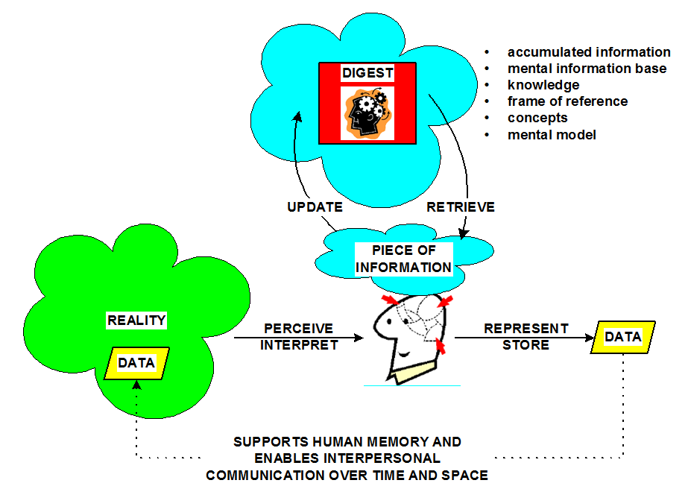
Reality – Information - Data

Slide 3
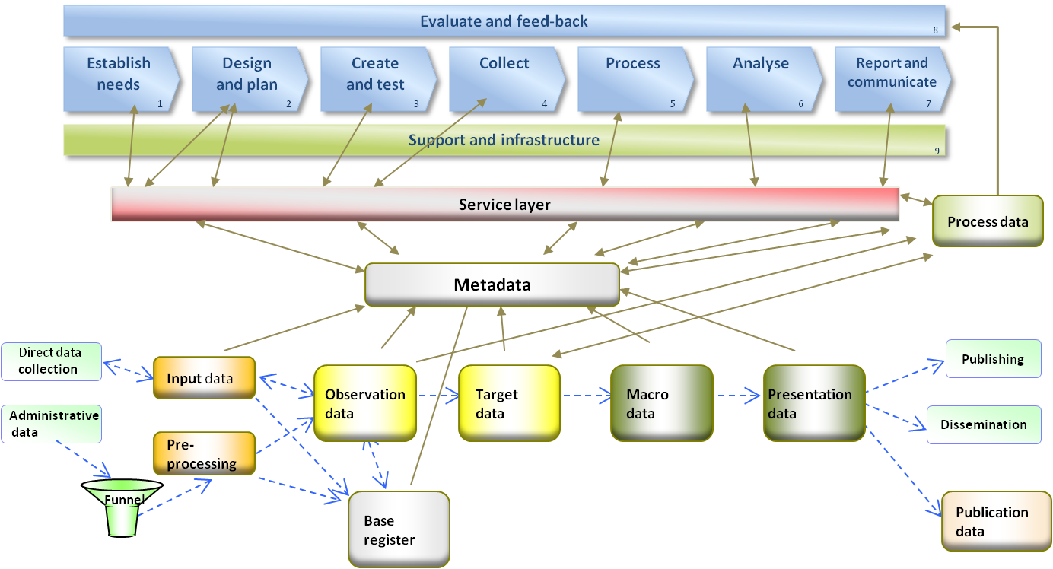
Metadata traditions
The statistical tradition (from 1973 and onwards)
The library tradition (e.g. Dublin Core)
The archive tradition (DDI)
Synthesis: business processes supported by information systems and a corporate data warehouse
Lundell (2009): Conceptual view of the data warehouse of Statistics Sweden

Slide 4
The statistical archive system
Established by Svein Nordbotten in the early 1960’s
Archive-statistical principles:
Reuse existing raw data from administrative and statistical sources – for statistical purposes
Continuous inflow of data (more or less)
Organise data in a systematic way: statistical file system, databases, data warehouse
Ad hoc production of statistics
Systematic descriptions and definitions of data:
data and table definition languages; Nordbotten (1967): ”Automatic Files in Statistical Systems”
metadata; Sundgren (1973): ”An Infological Approach to Data Bases”
Standardised definitions and identifiers enabling flexible integration and combination of data: registers, classifications, standard variables
Generalised software
See also:
The Ruggles Report (1965): ”Report of the Committee on the Preservation and Use of Economic Data”
EU(2009): ”The production method of EU statistics – a vision for the next decade”

Slide 5
The history of metadata
Researched and documented by professor Jane Greenberg, Director of the Metadata Research Center, University of North Carolina
Metadata and Digital Information (2009)
The first known reference to ”metadata” appears in Bo Sundgren (1973), An Infological Approach to Data Bases, pp 104-105
Claims in the 1990’s by Jack E Myers to be the originator and owner of the term ”metadata” were refuted by the U. S. legal system, with reference to Sundgren (1973) and ”the longstanding use of the term in the statistical community”.
In 1986 Myers had registered ”Metadata Inc” as a company, and ”Metadata” as trade mark of that company. He later started to threaten people and agencies in the U.S. with legal actions, if they did not stop using the term ”metadata” as a generic term.
The Solicitor of the U.S. Department of the Interior decided that "Metadata" has entered the public domain by becoming a general term.
Jack Myers has not been able to provide any documentation supporting his claim to have coined the term “metadata” in the 1960’s.

Slide 6
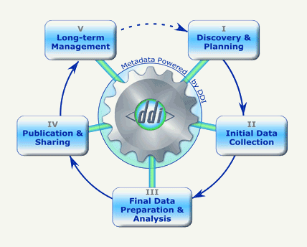
What is DDI? (1) ”A metadata specification for the social and behavioral sciences” ”Document your data across the life cycle”

Slide 7
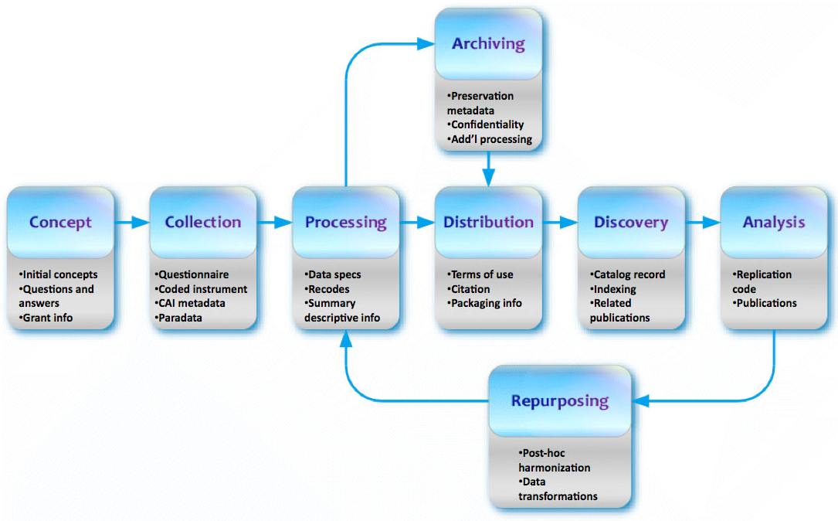
What is DDI? (2) ”supporting the entire research data life cycle”

Slide 8
What is DDI? (3)
DDI- Codebook (formerly DDI-2)
strictly data oriented
DDI- Lifecycle (formerly DDI-3)
process and data oriented

Slide 9
Life cycle models
Product life cycle (technical and marketing)
Systems development life cycle(waterfall etc)
Software development life cycle
Business process life cycle
Generic Statistical Business Process Model (GSBPM)
Data/metadata life cycle
Cycle de vie des données (CVD), Eurostat model
Combined life cycle
DDI-3: for the ”social science business”

Slide 10
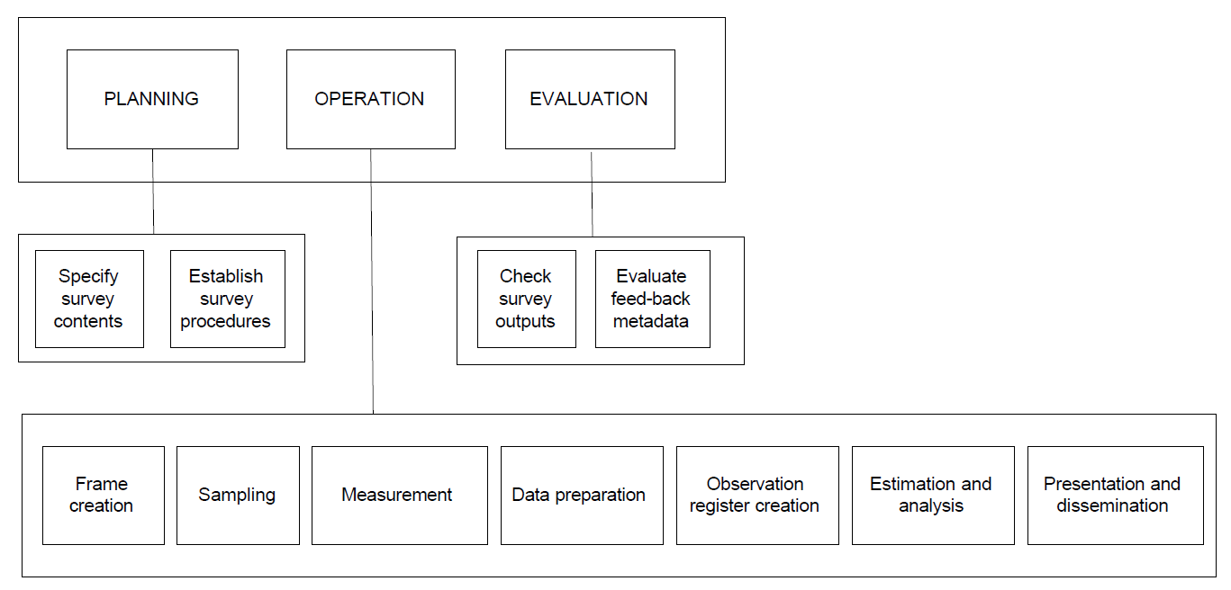
Architecture for statistical systems
Source: Information Systems Architecture for National and International Statistical Offices – Guidelines and Recommendations, United Nations, 1999, http://www.unece.org/stats/documents/information_systems_architecture/1.e.pdf

Slide 11
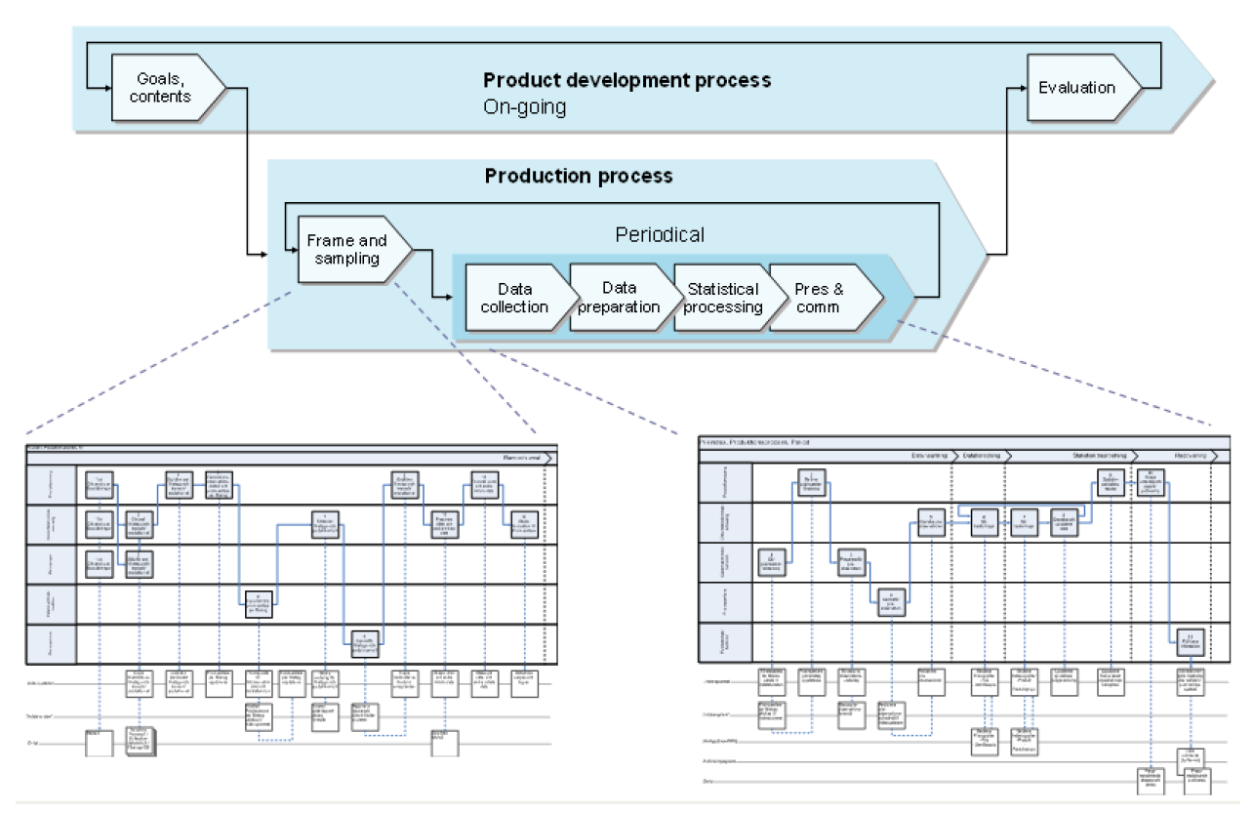
Statistics production: product development and production processes
Source: Sundgren (2007) “Process reengineering at Statistics Sweden”, MSIS Geneva.

Slide 12
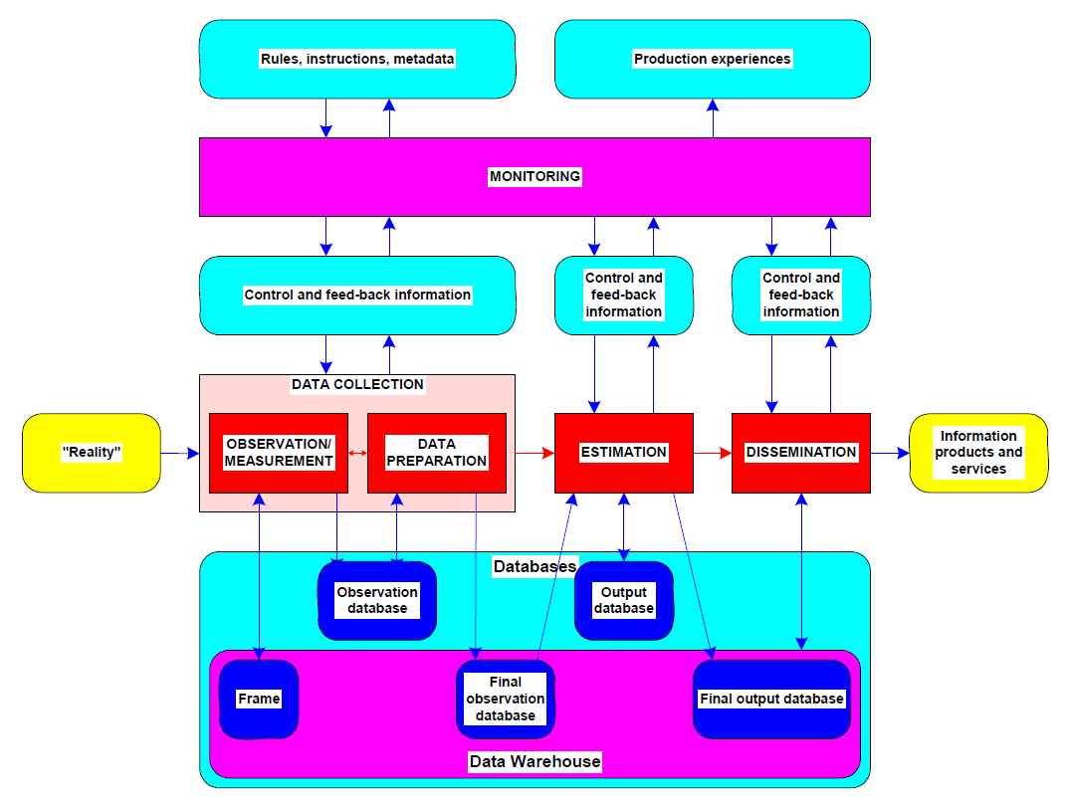
Basic operations in a database-oriented statistical system
Source: Sundgren (2004b) “Statistical systems – some fundamentals”.

Slide 13
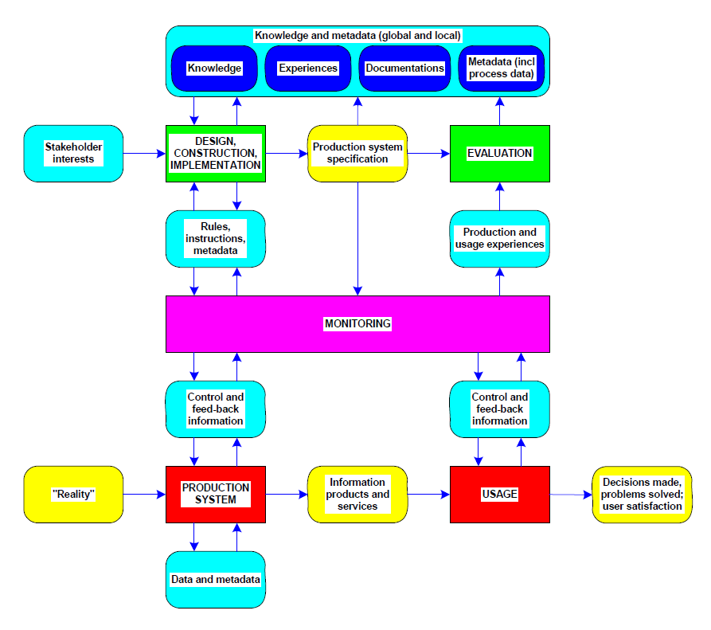
Control and execution of a statistical system
Source: Sundgren (2004b) “Statistical systems – some fundamentals”.

Slide 14
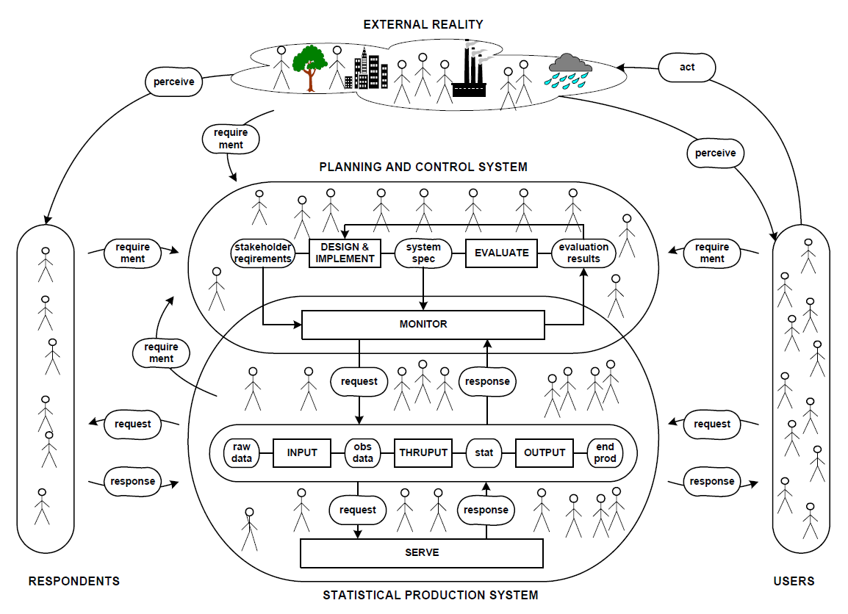
A statistical system and its environment
Source: Sundgren (2004b) “Statistical systems – some fundamentals”.

Slide 15
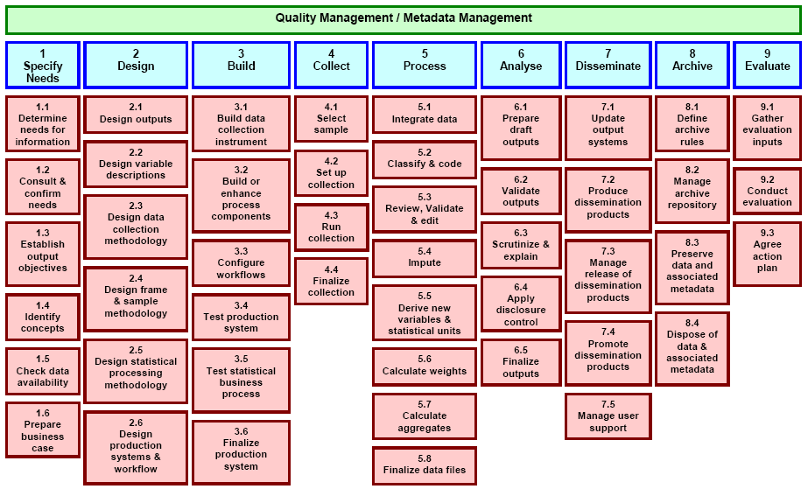
The Generic Statistical Business Process Model (GSBPM), levels 1 and 2
Source: UNECE (2009) “Generic Statistical Business Process Model”. Geneva.

Slide 16
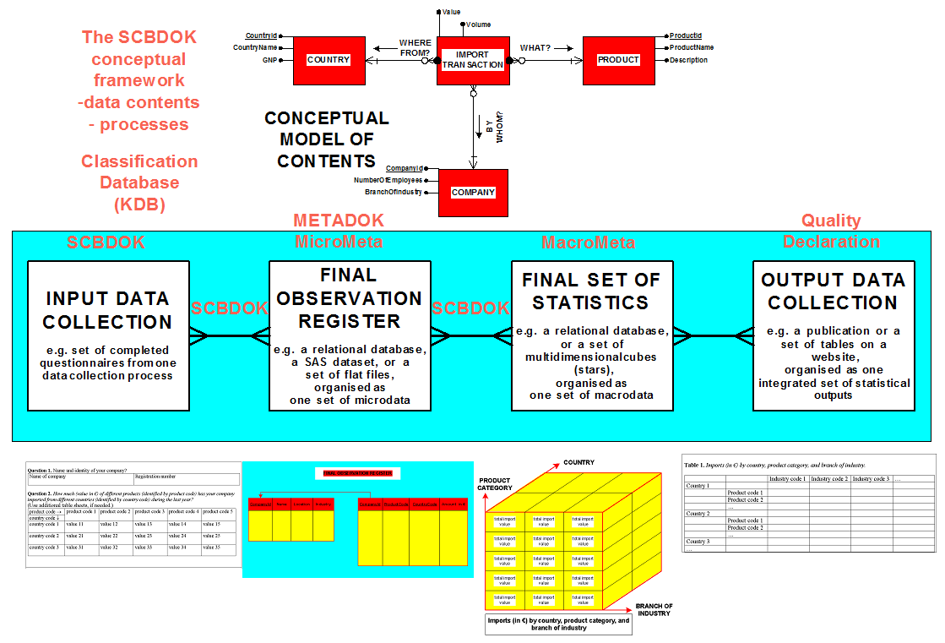
Focusing on data/metadata interfaces
Source: Sundgren&Lindblom (2004) “The metadata system at Statistics Sweden in an international perspective”, Prague.

Slide 17
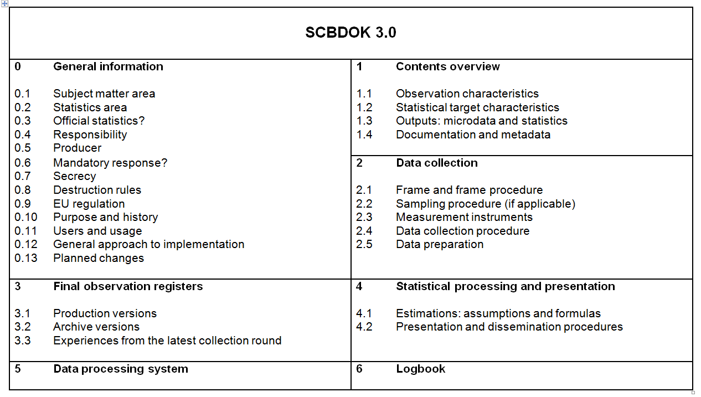
SCBDOK documentation template
Source: Sundgren (2001) “Documentation and quality in official statistics”.

Slide 18
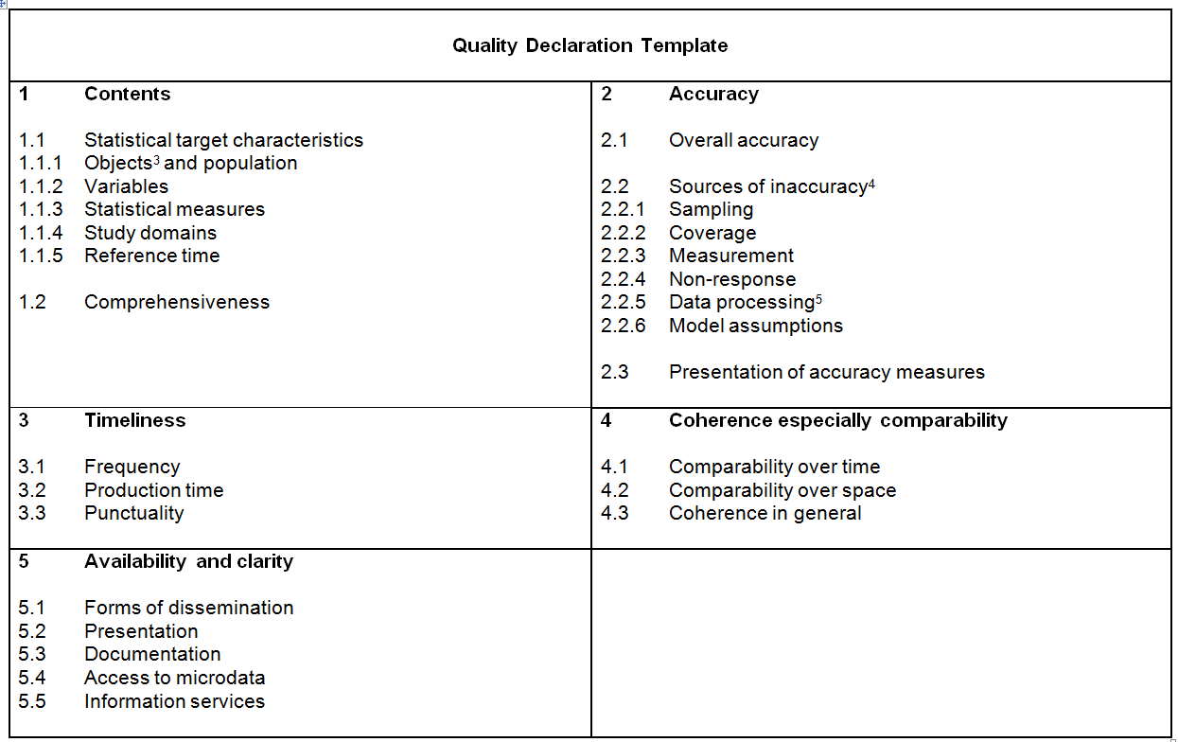
Quality Declaration Template
Source: Sundgren (2001) “Documentation and quality in official statistics”.

Slide 19
The quality of statistical data as affected by different discrepancies
Source: Sundgren (1995) Guidelines for the Modelling of Statistical Data and Metadata.

Slide 20
Discrepancies between reality ”as it is” and as it is reflected by statistics: which they are, and why and where they occur
caused by
design decisions
occurring during
operation processes
occurring during
use processes
Source: Sundgren (2004b) “Statistical systems – some fundamentals”.

Slide 21
Statistical characteristic
a statistical measure (m) applied on
the (true) values of a variable (V); V may be a vector
for the objects in a population (O)
O.V.m = statistical characteristic
O.V = object characteristic
V.m = parameter
Examples of statistical characteristics
number of persons living in Sweden at the end of 2001
average income of persons living in Sweden at the end of 2001
correlation between sex and income for persons living in Sweden at the end of 2001

Slide 22
Statistic
an estimator (e) applied on
observed values of an observed variable (V’);
for a set of observed objects (O’) allegedly belonging to a population (O)
Ideally the value of a statistic O’.V’.e should be ”close to the true value of the statistical characteristic O.V.m that it aims at estimating”
Examples
the estimated number of persons living in Sweden at the end of 2001
the estimated average income of persons living in Sweden at the end of 2001
the estimated correlation between sex and income for persons living in Sweden at the end of 2001

Slide 23
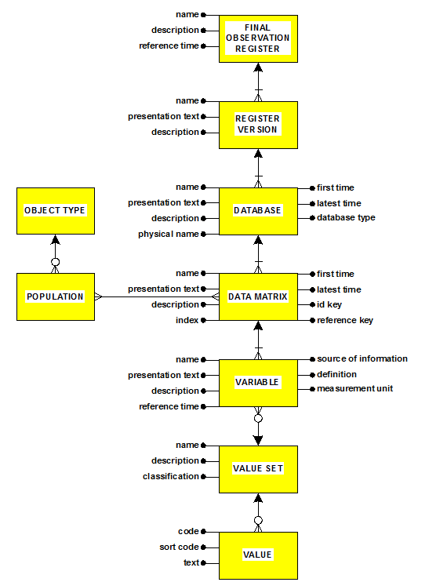
Metadata overview for final observation registers
Source: Sundgren&Lindblom (2004) “The metadata system at Statistics Sweden in an international perspective”

Slide 24
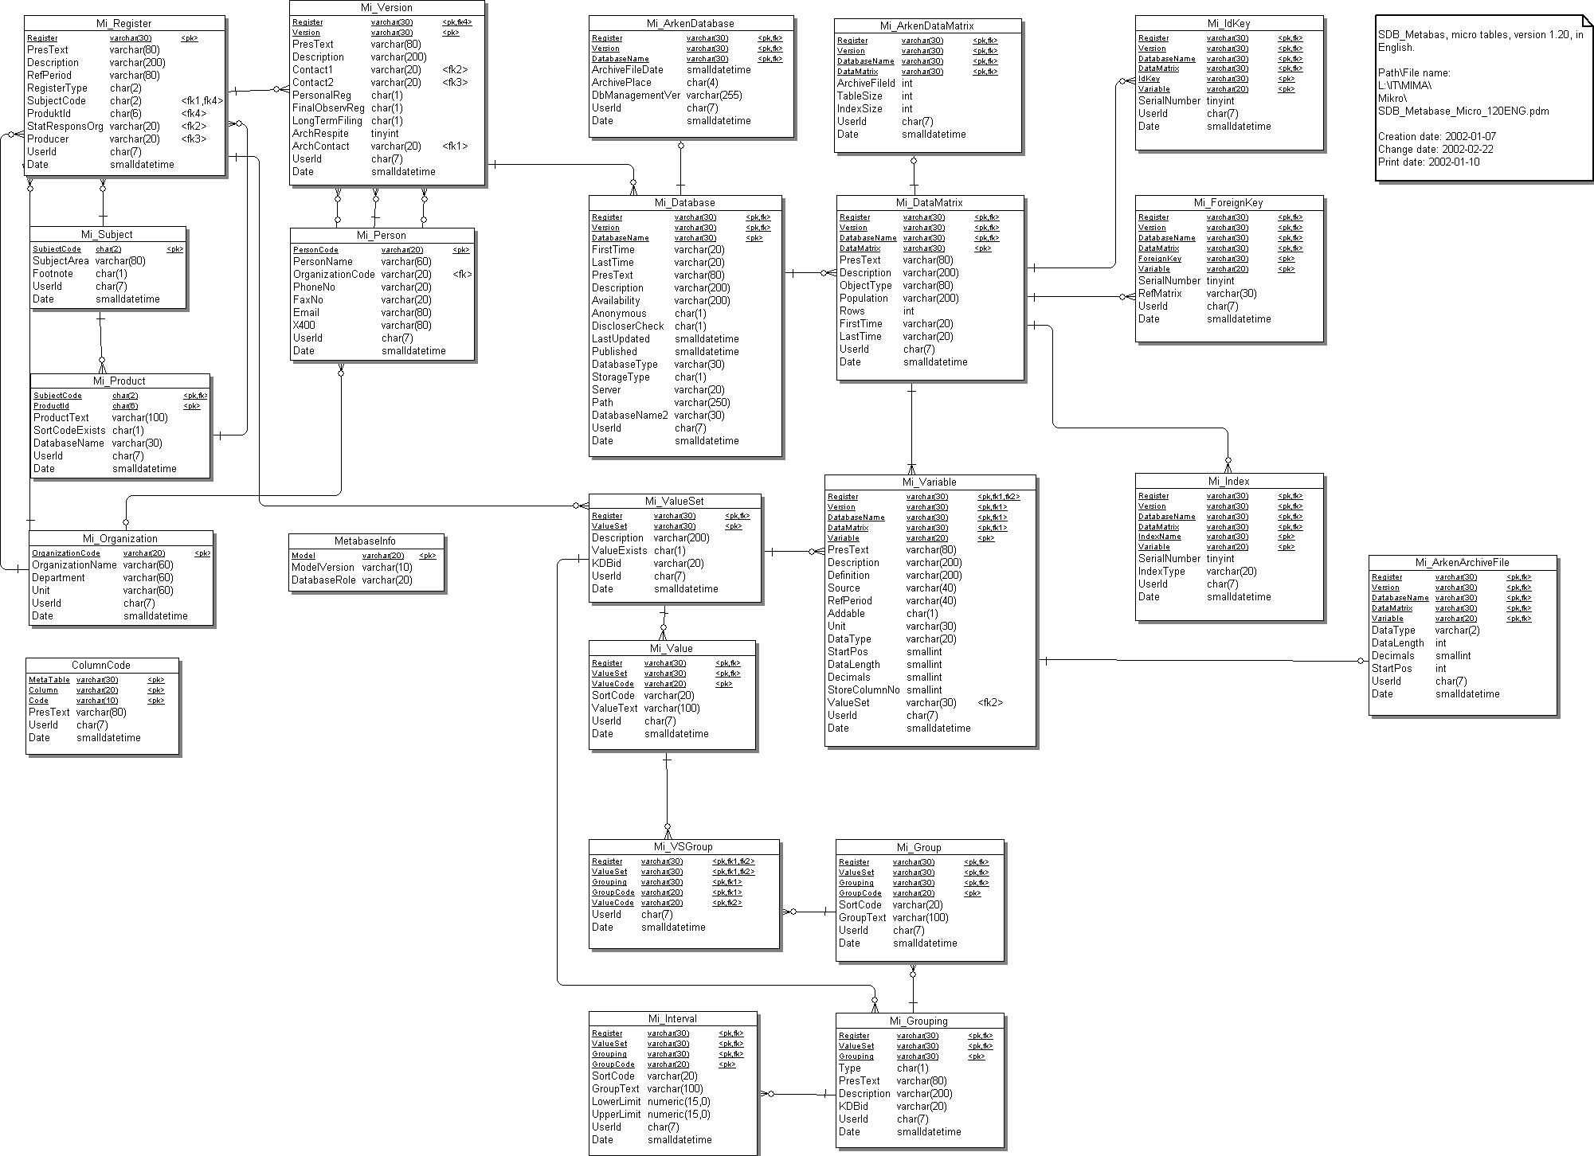
Complete MicroMeta model
Source: Sundgren&Lindblom (2004) “The metadata system at Statistics Sweden in an international perspective”

Slide 25
MacroMeta: simplified overview
Source: Sundgren&Lindblom (2004) “The metadata system at Statistics Sweden in an international perspective”

Slide 26
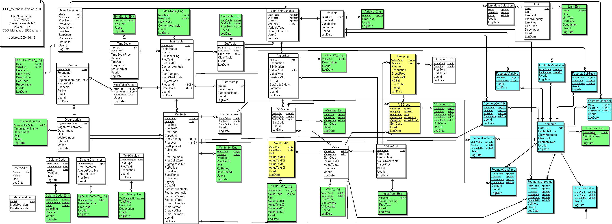
MacroMeta: complete model
Source: Sundgren&Lindblom (2004) “The metadata system at Statistics Sweden in an international perspective”

Slide 27
Three critical success factors for documentation and metadata
Motivation: How to respond to the arguments against documentation-related work?
Contents: Which metadata are needed by which stakeholders for which purposes?
Management: How to manage a metadata system in an efficient and sustainable way?

Slide 28
Arguments against documentation
Time and costs: ”we don’t have the resources”
”We have more important things to do”
Dull, not fun, not rewarding
Competent key persons are scarce resources
”I know everything – come to me and ask”
”I don’t want to lose my knowledge monopoly”
”The users don’t ask for documentation”
Easy-to-use tools are not available
Documentation is produced as a separate activity
There are too many types of documentation, contents overlapping and not well motivated, duplication of work

Slide 29
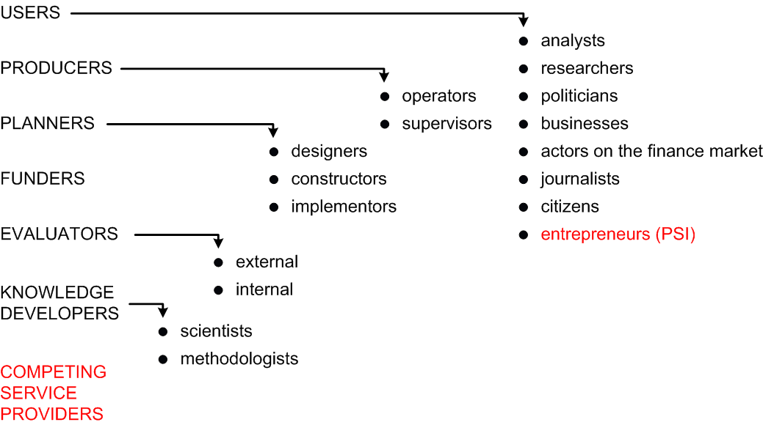
Stakeholders in official statistics and in metadata about official statistics

Slide 30
Documentation/metadata objects
Datasets
information contents
object types and populations
object relations and relational objects
variables and value sets
physical datasets
Processes and systems
Instruments and tools
methods, algorithms, programs
questionnaires and other measurement instruments
registers, classifications, other auxiliary datasets
metadata, documentation

Slide 31
Documentation/metadata variables
For datasets:
definitions, verbal or formal
quality variables, by quality component
technical metadata, e.g. storage format
For processes and systems:
references to input and output datasets
references to instruments and tools
process data (paradata) generated by the processes
For instruments and tools:
documentation of instruments and tools
the instruments and tools themselves (in extenso)
references to systems and processes using them
user experiences

Slide 32
Use, production, and recycling of documentation and metadata

Slide 33
The Swedish Statistics Commission
Set up by the Swedish government to evaluate and improve Statistics Sweden and the Swedish Statistical System
Principal investigator: Bengt Westerberg, a former minister of social affairs and leader of the Swedish Liberal Party
10 experts
Final report to be delivered in December 2012

Slide 34
Some tasks of the Statistics Commission
Analyse centralised vs decentralised system
Examine in particular the quality and accessibility of statistics, including documentation, pricing, and confidentiality
Analyse what it means for statistics production that state authorities as a rule should not sell goods and services on the market
Analyse the impact on SCB of the PSI Act
Propose measures to ensure and improve quality, accessibility, and documentation, including a monitoring system
Propose a strengthening of SCB’s cooperation with universities and other agencies
Propose how the system of official statistics should be designed
Propose changes in Swedish regulations as the result of new regulations and expected changes on the European level, e.g. the Code of Practice for European Statistics, the PSI Directive, and ”the EU vision for official statistics” (see enclosed slide)
Propose any constitutional amendments deemed necessary

Slide 35
Summary of my proposals concerning quality, availability, and documentation
Independent monitoring system
Free access to methods and tools (software, databases, registers, metadata, documentation, etc) that have been developed for official statistics and funded by public money
Continuously ongoing development of knowledge, methods, and general tools, funded by public money
Systematic implementation of best practices

Slide 36
Summary of the EU vision for official statistics
Current situation: the augmented stovepipe model
respondents asked for the same information more than once
not adapted to collect data across domains
little standardisation and coordination between areas
Demands for change:
new information needs, often across domains, often ad hoc (e.g. in crises)
decrease reponse burden
use new ICT methods and tools to increase efficiency
Consequences on the level of Member States:
holistic approach, stovepipes replaced by integrated production systems around a data warehouse
data obtained from existing administrative data and/or extracted directly from company accounts, combining survey data with administrative data, new efforts to ensure the quality of the data
Consequences on the EU level:
Horizontal integration similar to the Meber State level
Two elements of vertical integration: (i) collaborative networks, and
(ii) direct production for the EU level, when there is no need for national data

Slide 37
Golden rules for metadata systems
Experiences of metadata systems from Sweden and elsewhere have been summarized in a set of “golden rules”, aiming at designers, project managers/co-coordinators, and top managers, respectively.
The rules are formulated and elaborated in:
Sundgren (2003a) “Developing and implementing statistical metainformation systems”, Deliverable from EU project
Sundgren (2003b) “Strategies for development and implementation of statistical metadata systems”, ISI Berlin
Sundgren & Lindblom (2004) “The metadata system at Statistics Sweden in an international perspective”, Prague
Sundgren (2004) “Metadata systems in statistical production processes – For which purposes are they needed, and how can they best be organised?”, UNECE/Eurostat/OECD, Geneva

Slide 38
Golden rules (1): If you are a designer…
Make metadata-related work an integrated part of the business processes of the organisation.
Capture metadata at their natural sources, preferably as by-products of other processes.
Never capture the same metadata twice.
Avoid un-coordinated capturing of similar metadata – build value chains instead.
Whenever a new metadata need occurs, try to satisfy it by using and transforming existing metadata, possibly enriched by some additional, non-redundant metadata input.
Transform data and accompanying metadata in synchronised, parallel processes, fully automated whenever possible.
Do not forget that metadata have to be updated and maintained, and that old versions may often have to be preserved.

Slide 39
Golden rules 2: If you are the project co-ordinator…
Make sure that there are clearly identified “customers” for all metadata processes, and that all metadata capturing will create value for stakeholders.
Form coalitions around metadata projects.
Make sure that top management is committed. Most metadata projects are dependent on constructive co-operation from all parts of the organisation.
Organise the metadata project in such a way that it brings about concrete and useful results at regular and frequent intervals.

Slide 40
Golden rules (3): If you are the top manager…
Make sure that your organisation has a metadata strategy, including a global architecture and an implementation plan, and check how proposed metadata projects fit into the strategy.
Either commit yourself to a metadata project – or don’t let it happen. Lukewarm enthusiasm is the last thing a metadata project needs.
If a metadata project should go wrong – cancel it; don’t throw good money after bad money.
When a metadata project fails, make a diagnosis, learn from the mistakes, and do it better next time.
Make sure that your organisation also learns from failures and successes in other statistical organisations.
Make systematic use of metadata systems for capturing and organising tacit knowledge of individual persons in order to make it available to the organisation as a whole and to external users of statistics.

Slide 41
Thank you for your attention!

